Slide 1
Student Behavioral Patterns in Online Learning Platform
CECS 456: Machine Learning
Spring 2023
Group #13:
Jason Jistiripol
Ryan Gieg
Ryo Fujimura
Jovanni Garcia
Joshua Gherman
Chase Aufmann
Matthew Kriesel
Carlos Bardello

Slide 2
Introduction
Topic: Student behavioral patterns and correlation between attendance and grades.
Approach:
K-means clustering algorithms
Elbow and silhouette methods
Hierarchical clustering algorithm (HDBSCAN)

Slide 3
Related Work
Background:
Existing research using unsupervised clustering techniques on student datasets
Diverse clustering algorithms and datasets explored in literature (including ethnicity, gender)
Gap in Literature:
No recent research article found using the same EPM dataset as our study
Our Contribution:
Unique perspective on the EPM dataset
Detailed deconstruction and analysis of data
Extensibility of the methods to the other datasets.

Slide 4
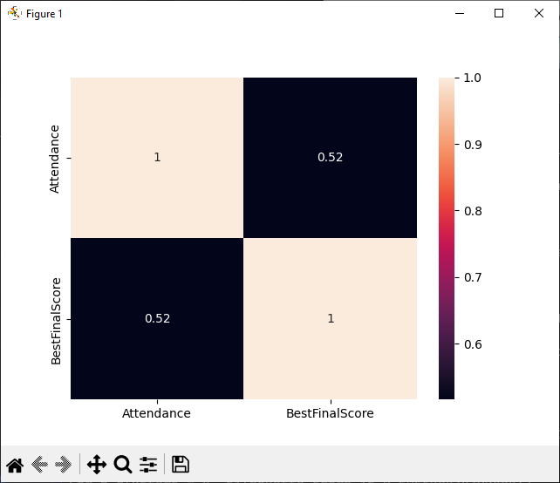
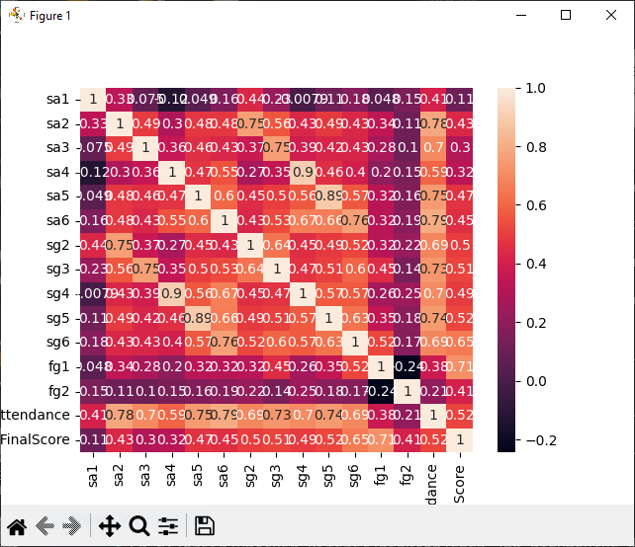
Dataset
Source: UCI Machine Learning Repository
Dataset: Educational Process Mining
Focus: 115 first-year undergraduate engineering
-----majors at the University of Genoa
Student data
Attendance records
Grades achieved for each session
Final grades
Identify the outliers in the dataset
Plot the correlation matrix for the dataset.
Plot the graphical distribution for the variables

Slide 5
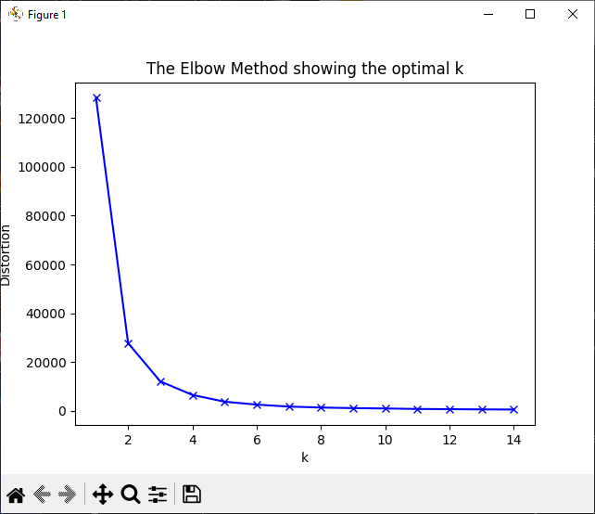
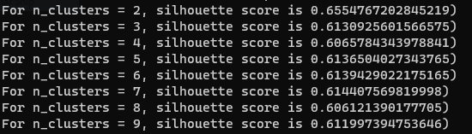
Methods
Simplified dataset:
Attendance and BestFinalScores columns
Full dataset with PCA (5 components)
Elbow Method
WCSS value evaluated for 1-15 clusters
Utilized KMeans library
Figure 8.1: optimal k determined for clustering algorithm

Slide 6
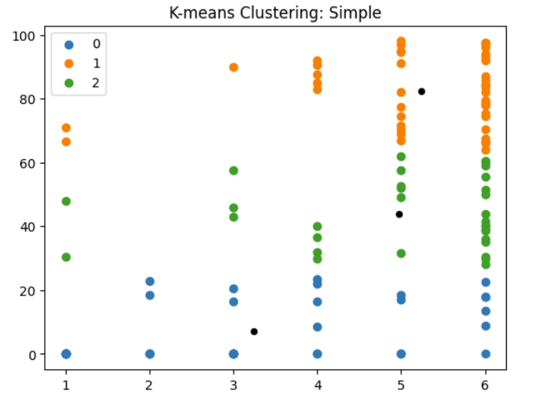
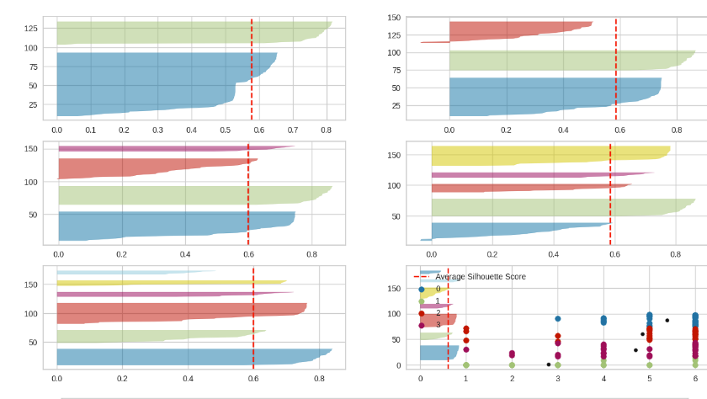
Methods Continued
Silhouette Method
Average silhouette score for range of k values
Same k range and centroid seeds as Elbow Method
Figure 8.2: linear graph of silhouette scores
Figure 8.3: silhouette graphs for each cluster

Slide 7
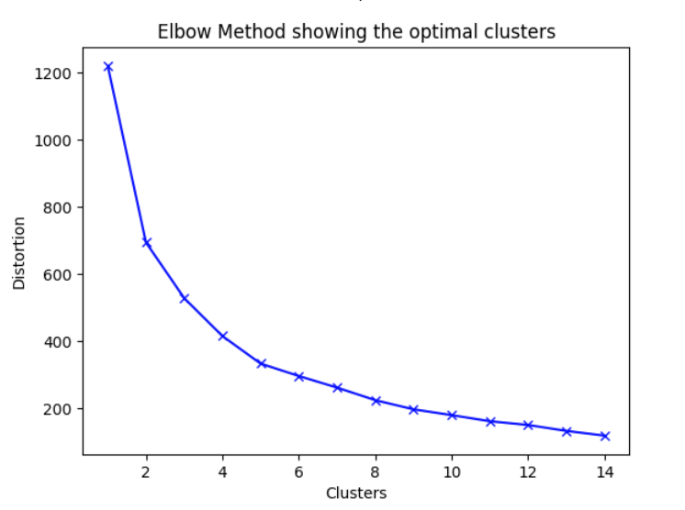
Methods Continued
K-means Clustering
Based on optimal clusters from Elbow & Silhouette Methods
Black dots: centroids of cluster groups
Figure 8.4: 2D graph with Attendance & BestFinalScores

Slide 8
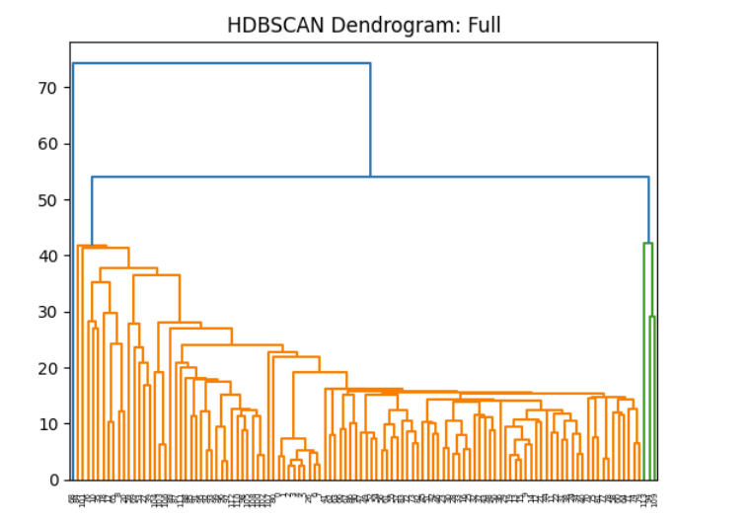
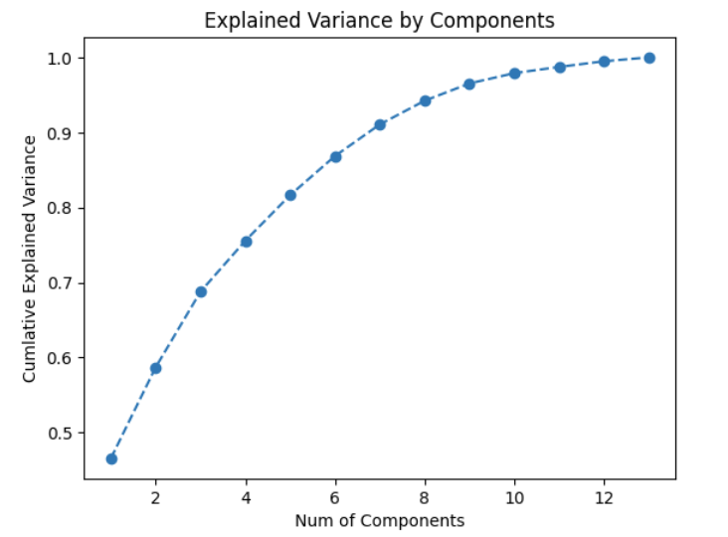
Methods Continued
Figure 8.7: dendrogram of hierarchical clustering
HDBSCAN
Hierarchical Density-based Spatial Clustering of Applications with Noise
Clusters dense data points, finds most stable clusters
Figure 8.7: dendrogram of hierarchical clustering
Figure 8.8: dendrogram with full dataset scope
Key takeaways
Different clustering methods offer unique insights
Consideration of noise and skewness in the dataset
Clustering outcomes inform further analysis and understanding
Figure 8.8: dendrogram with full dataset scope

Slide 9
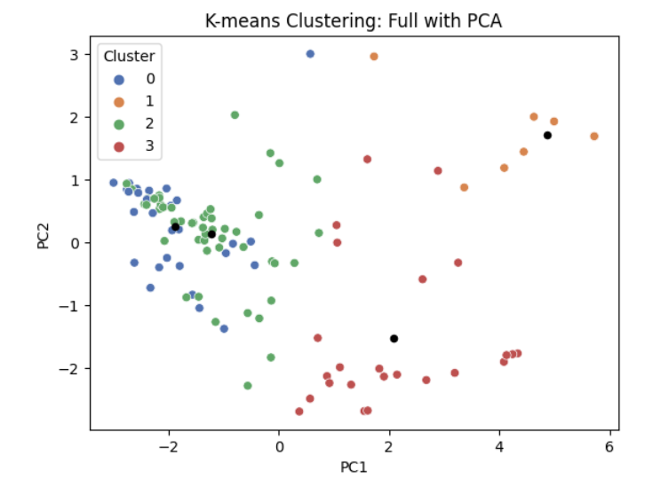
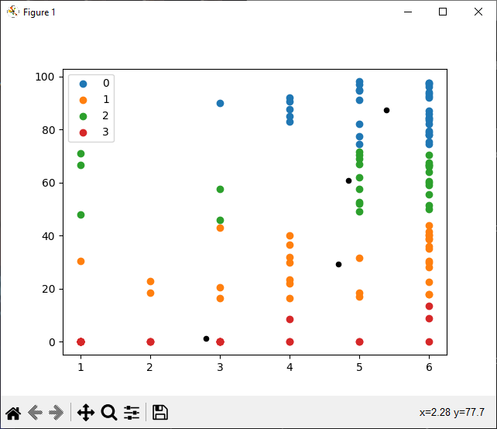
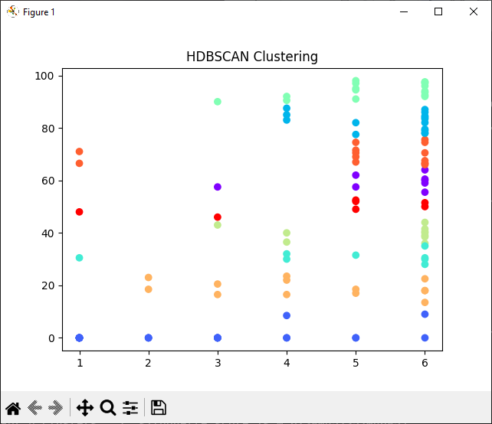
Results
Exploratory Data Analysis results
Positive correlation between class attendance and final grade
Outliers skewing the mean
Correlation Matrix best represents the data
Elbow method findings
Optimal number of clusters: 3
Weakness: lacks depth in determining exact optimality
Full dataset suggests 2-5 clusters as optimal
Silhouette method findings
More accurate than the elbow method
Optimal number of clusters: 4
Silhouette scores for n_clusters 2-7 provided
K-means clustering results
3 clusters identified
Clustered students based on grade brackets and attendance behavior
HDBSCAN algorithm results
Determined 9 clusters as most stable
Clustered students based on attendance and grade letters
Dendrogram illustrates other potential cluster groups
Key insights
Both clustering algorithms show strong connection between attendance and grades
Outliers identified and considered in analysis
Different methodologies provided varying optimal cluster numbers

Slide 10
Conclusion
Conducted exploratory data analysis
Visualized and summarized dataset
Gained insights to inform machine learning approach
Investigated correlation between student behavior and test scores
Analyzed attendance, study habits, and other relevant factors
Implemented two clustering algorithms
K-means clustering
Hierarchical Density-Based Spatial Clustering of Applications with Noise (HDBSCAN)
Determined optimal k value for K-means clustering
Employed elbow method
Utilized silhouette method
Validated results with cross-validation
Addressed data skewness and outliers
Acknowledged students with high test scores and low attendance
Assessed impact on clustering results
HDBSCAN clustering algorithm
Easy to implement with existing library
Algorithm handles most of the work automatically
Overall findings and next steps
Identified patterns and relationships in student behavior and test scores
Informed future interventions and educational strategies

